Slide 1

Xperiments Submission
October 2021

Slide 2
Category
Explain the category if you have chosen any and the reason to choose. (ignore if self chosen category)
Category chosen is Touchless Authentication
In Today’s world with COVID-19 everyone is concerned about their health, cleanliness & distancing. People avoids to physically interact with public system which needs physical touch.
Like for authentication in offices they use biometrics in which everyone has to touch it which can lead to as virus transmitter.
So to counter this, we have chosen to introduce an authentication system which is more reliable and touchless at the same time.

Slide 3

Problem
Modify Biometric Attendance System
Since it is the period of COVID-19, all the people are focusing towards their health, Biometric Attendance systems which are installed in various sectors like malls, Schools, Hospitals can be a nightmare for various people. People are creating many innovative ideas of contactless approach.
There are some loopholes in the current Biometric attendance system,
Let us discuss some loopholes :-
Data can be easily tampered.
A person can roam easily after giving the attendance without getting caught.
Electricity Depended.
Installation is very expensive.
Sometimes Inaccurate.

Slide 4
Solution
Tell us how you have solved the problem.
After careful observation we have come with an approach which solves the problems in existing systems, we have created an app (TRINETRA) which will enable every user to give attendance remotely instead of a using a single fingerprint scanner.
This will enable them to give the attendance from their mobile phones. After successful registration of employees on the admin panel, all the employees will receive notification to give attendance at the start and the end of the session with their mobile’s fingerprint sensor or by verifying their Face IDs.
The employees will additionally have to give attendance a few more times asked randomly on the same day
during their work shift.
After successful verification, their geolocation details will be sent to the database in the cloud, if the employee at the time of attendance mapped outside the periphery of the building, his/her attendance fails for that day.
The admin can view all the attendance information and statistics from their admin panel.

Slide 5
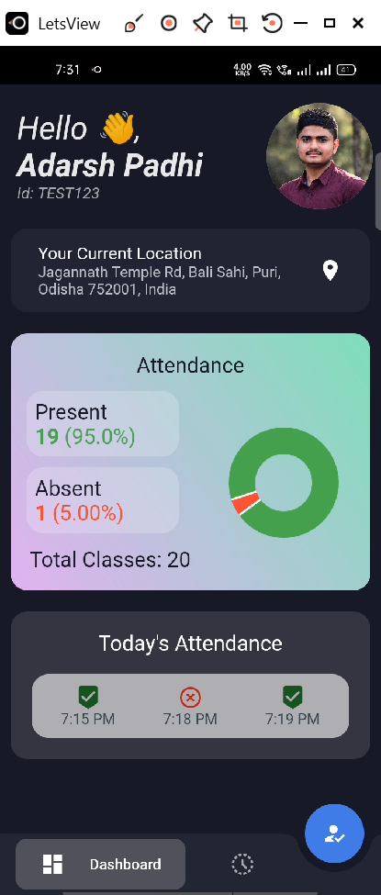

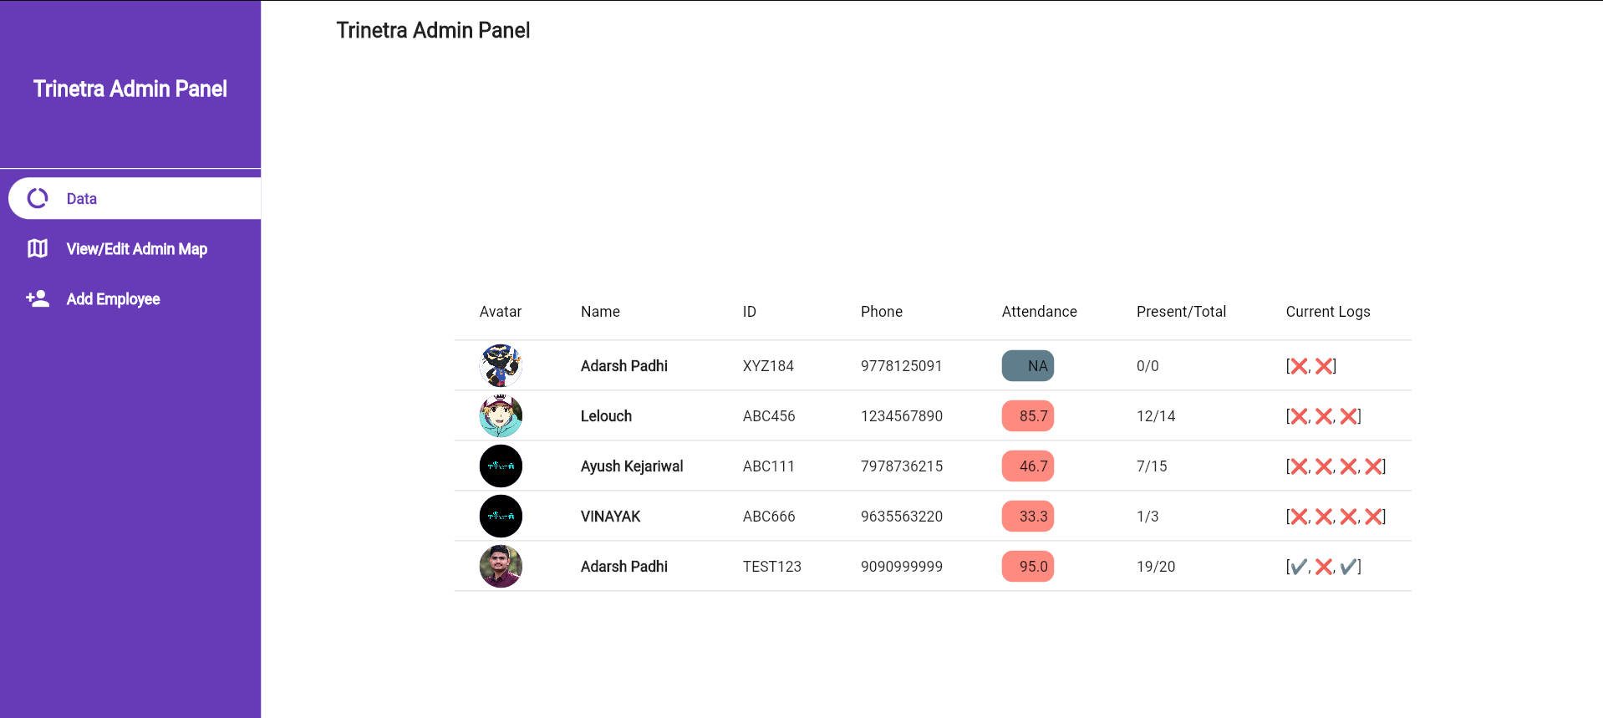
Product Demo Screens
YouTube Link: Trinetra Demo Video
Client
Application
Admin Panel

Slide 6




Technology used
Architecture or logos of the technology used.
Flutter
The client app and admin panel website are built using Flutter. This sped up the development cycle by intuitive UI.
Firebase
Firebase FCM feature is used for sending notifications to all the client users and notice.
Flask
The backend is powered by Flask which handles all functions like connecting to MongoDB, user authentication, location verification, building statistics etc.
Heroku
Heroku, a PaaS service, was used to easily deploy the Flask backend to be used by the client app and admin panel.

Slide 7


Competition
Tell us about your competitors in the market add their logos & text here
Our solution Trinetra, is an E-biometric attendance system, currently in the market (as per our research) there is no E-biometric attendance app, where users can give attendance from their phone, so our idea is unique, but there are companies which can be a good competitors for our idea, as they already know about biometric system management,
Our competitors are companies like MANTRA because they have strong network of biometric attendance system management, so they can enhance our idea and approach to audience with their solution.
Also, EasyAttendence platform will be a competition for us as their idea is quite similar to us of E-attendance system.
.

Slide 8

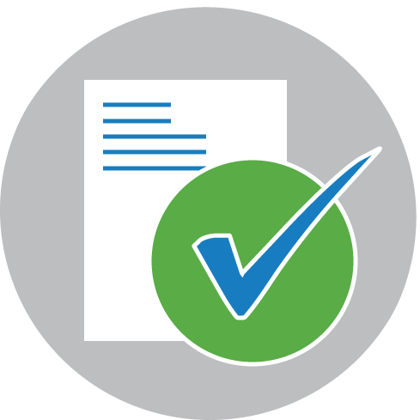

Competitive advantage
Data cannot be tampered easily
We will send user attendance with current location and timestamp so that data is secure,.
Accurate Data
User’s attendance is accurate and user and admin can see per day shift wise attendance.
Our app is free for everyone*
Installation and maintenance of the app is free.
*Companies can choose affordable plans based on number of employees they want to register.

Slide 9
References
As our idea is in development process, so we may not suggest many references, but we have taken help of research papers, to understand more about biometric system management. Following are the paper citations:
1. M. Hu and H. Li, "Application of Location-Controlled Mobile Attendance Recording System in College Classroom Teaching," 2020 International Symposium on Educational Technology (ISET), Bangkok, Thailand, 2020, pp. 18-22, doi: 10.1109/ISET49818.2020.00014.
2. S. A. M. Noor, N. Zaini, M. F. A. Latip and N. Hamzah, "Android-based attendance management system," 2015 IEEE Conference on Systems, Process and Control (ICSPC), Bandar Sunway, Malaysia, 2015, pp. 118-122, doi: 10.1109/SPC.2015.7473570.
3. Pallavi Verma and Namit Gupta, "Fingerprint Based Student Attendance System Using GSM", International Journal of Science and Research (IJSR), pp. 2319-7064.

Slide 10
Roadmap: Idea to Product
Explain tentative plan how your submission can be converted to a full-fledged product
Our product can be used by various MNCs , cooperative sectors, educational institutions & even for individual use.
We can collaborate with government and this can used in several government establishments like hospitals , schools , college, etc.
Since it follows a non-contact approach, it will surely be an advantage with respect to current scenario.

Slide 11
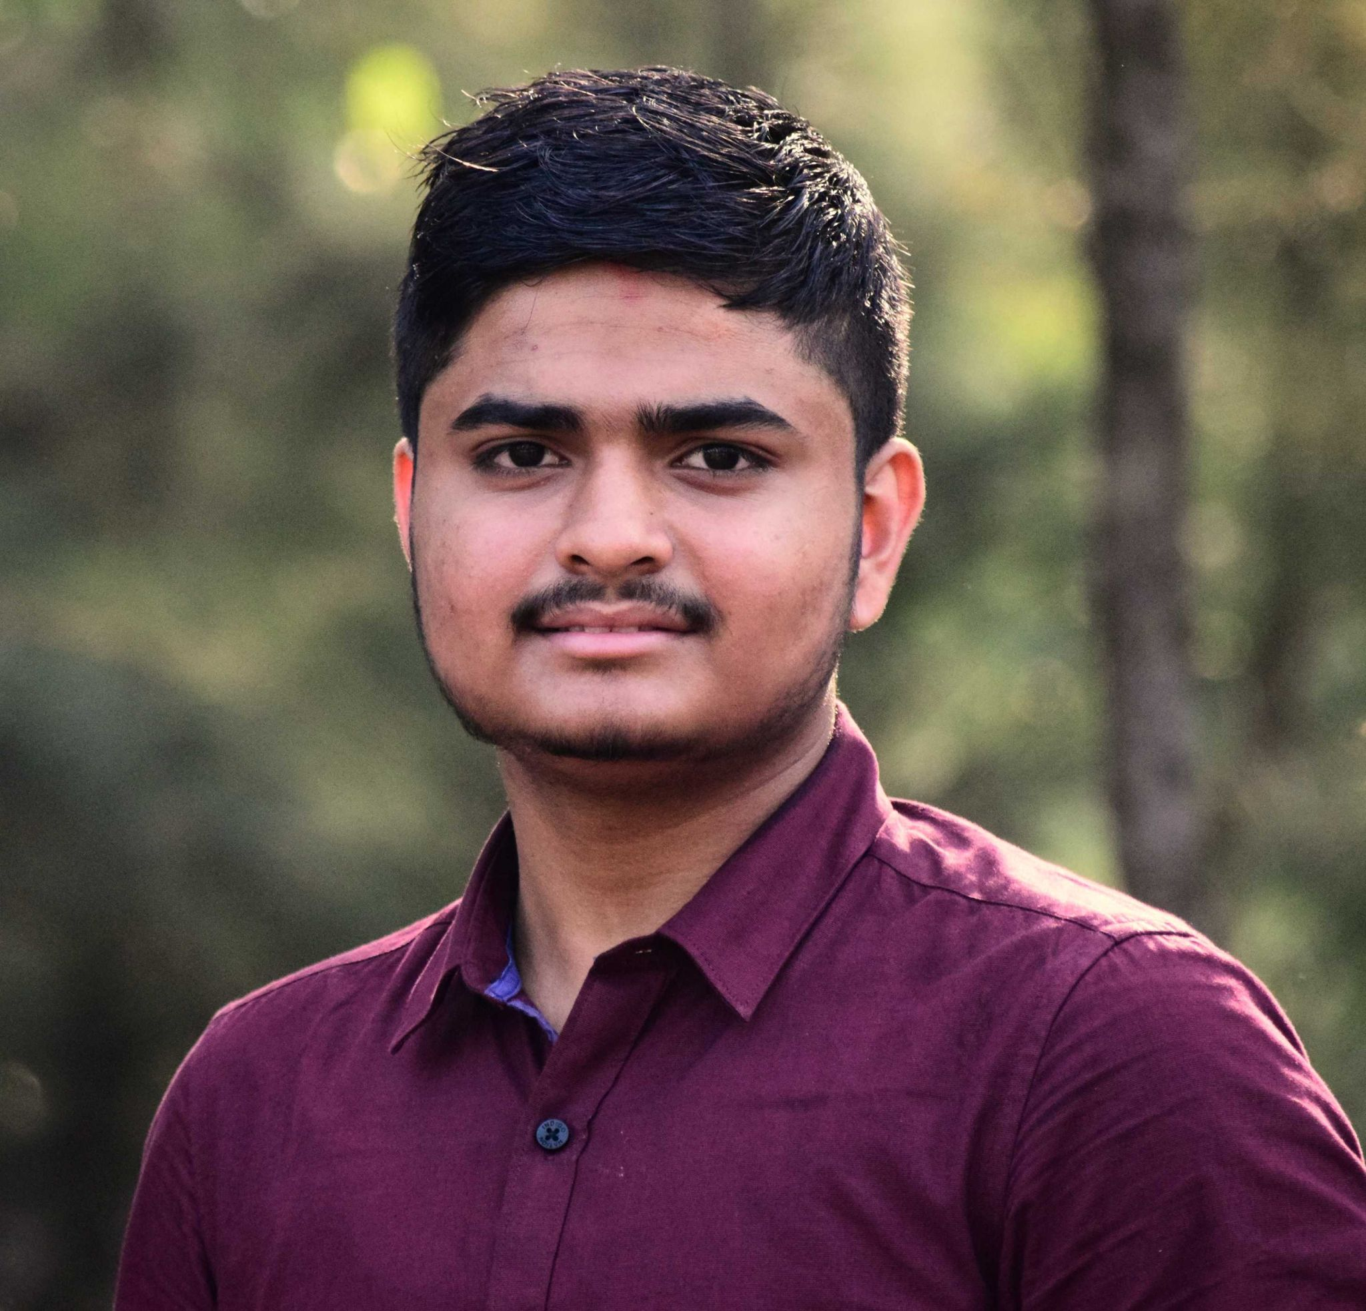
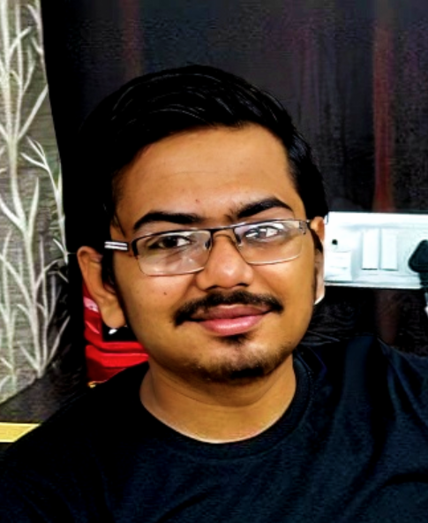
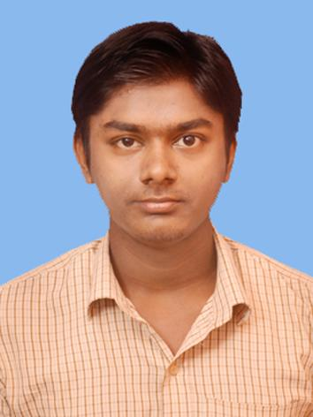
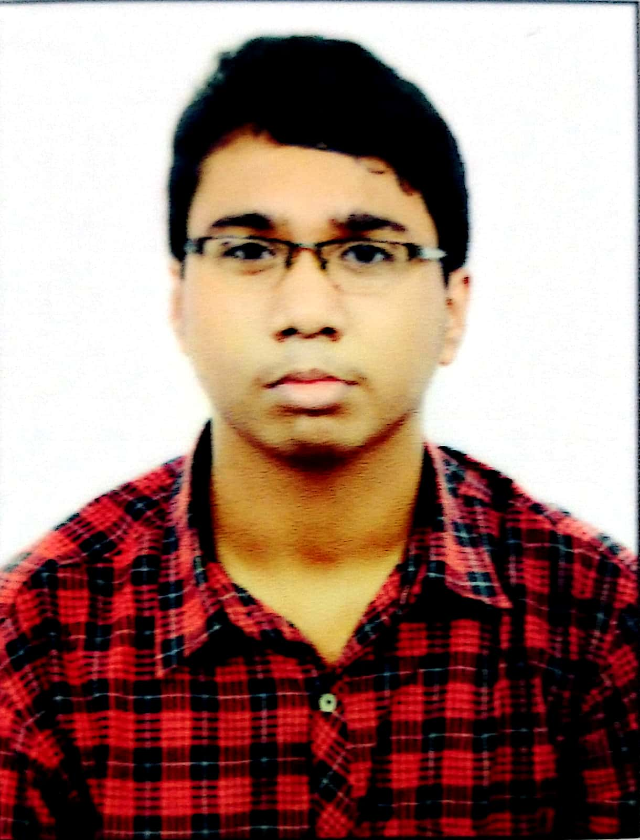
Our team
Adarsh Padhi
4th year, CSE
Ayush Kejariwal
3rd year, CSE
Gyanaranjan Sahoo
3rd year, CSE
ASVK Vinayak
3rd year, CSE

Slide 12




Thank You
Together, let’s build for boundless impact
www.ust.com I www.blueconchtech.com

